Slide 1
My Instruction Manual
Pathways Innovative Planning Level3
Know your sense of humor project
This project focuses on understanding what makes you laugh and how to share that with an audience.

Slide 2
What do you do first when you buy a new product?

Slide 3
What do you do first when you buy a new product?
Read an instruction manual

Slide 4
What do you do when you meet people at first time?

Slide 5
What do you do when you meet people at first time?
I have no idea!

Slide 6
What do you do when you meet people at first time?
Small talk?
It is fine today!

Slide 7
What do you do when you meet people at first time?
Small talk is not small for me at all.
It's a huge talk!

Slide 8
Nice idea!
Why not having my own instruction manual and ask them to follow it!

Slide 9
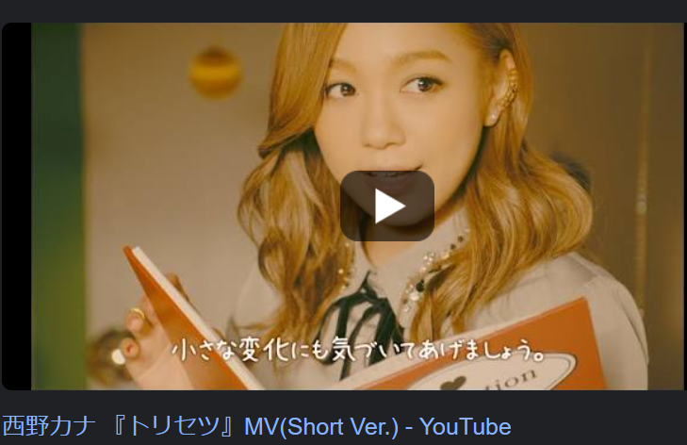
Speaking about an instruction manual

Slide 10
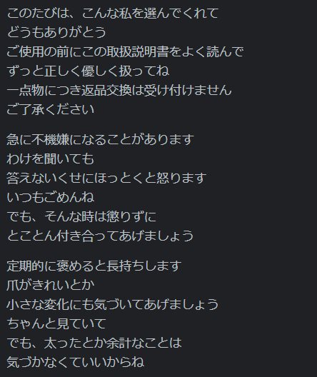
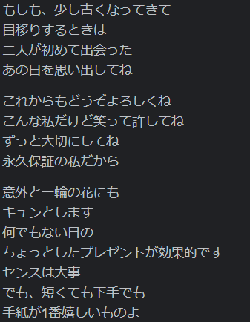
Speaking about an instruction manual

Slide 11
Speaking about an instruction manual
Too Much
めんどくさい

Slide 12
Let's make my own instruction manual!
But....

Slide 13
Let's make my own instruction manual!
I don't know myself at all

Slide 14

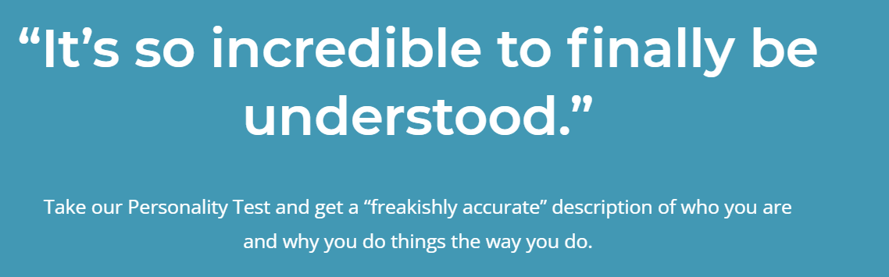
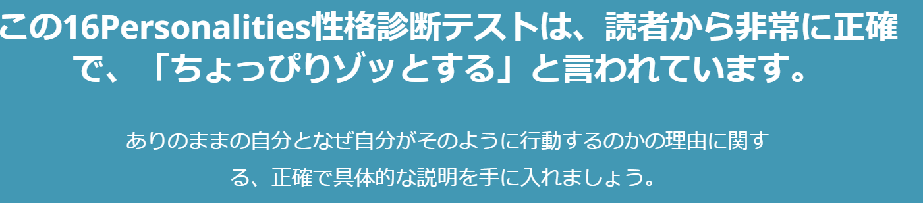
Take an assessment!

Slide 15


Result!

Slide 16
Result!
What is INTP? Logician?

Slide 17
What is INTP?
Ask Google!

Slide 18
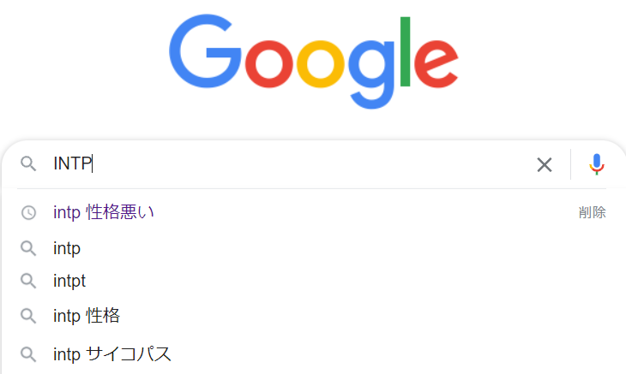
What is INTP?

Slide 19
What is INTP?
I'm psychopath!

Slide 20
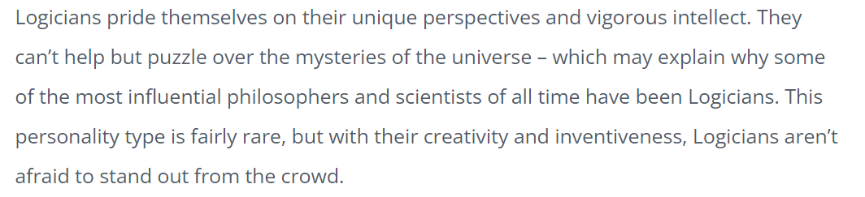
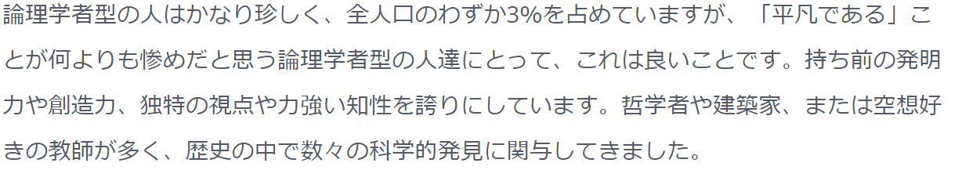


Detail of INTP

Slide 21
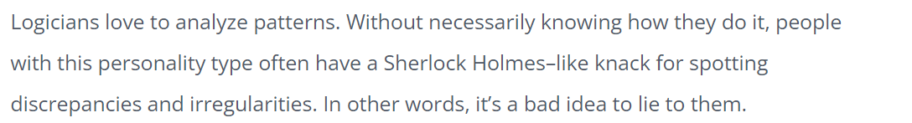
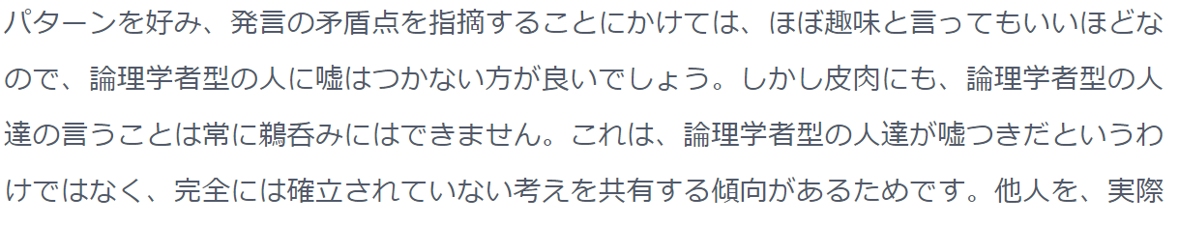

Detail of INTP

Slide 22
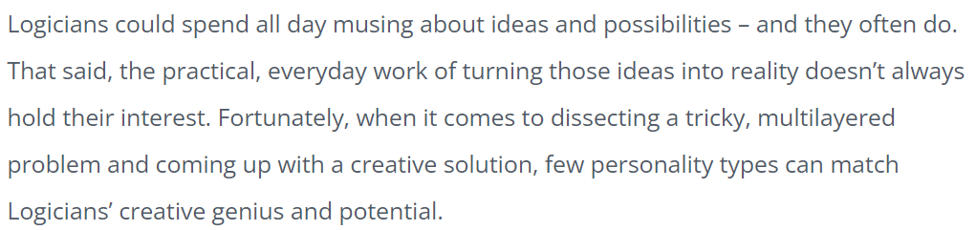
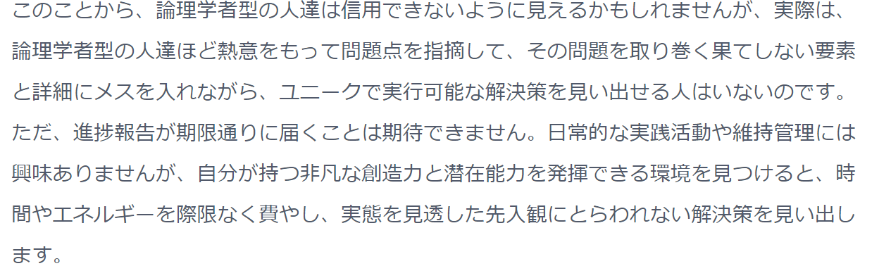



Detail of INTP

Slide 23
What is INTP?
Perfect description of myself!
I got my instruction manual now!!

Slide 24
Now, I got my instruction manual
How to use my manual

Slide 25
How to use my instruction manual
Show it to the person I've never met
Ask them to follow the manual when they want to talk to me
Then, we can have a better communication!!

Slide 26
Key take aways
What are important for better communication.
Know yourself
Express yourself

Slide 27
Thank you for listening!!

Slide 28
Wait a moment!
It is nothing humorous, isn't it?

Slide 29
True take aways
Show it to the person I've never met
Ask them to follow the manual when they want to talk to me
If this doesn't work.......

Slide 30
True take aways
3. If this doesn't work.......
4. It is their fault as they don't follow the instruction

Slide 31
True take aways
Any results caused by misuse of the product is out of warranty
正しい使われ方をしなかった場合に発生するあらゆる結果は保証の対象外です

Slide 32
Then, we are free from the responsibilities of the miscommunication

Slide 33
Thank you for listening!!

